Slide 1
Guest Lecture Stanford ME469: A Validation Methodology:
Code and Solution Verification
Stefan P. Domino
Computational Thermal and Fluid Mechanics
Sandia National Laboratories SAND2018-4536 PE

Slide 2
A Validation Methodology: Code and Solution Verification: Outline
Elements of a Poor-Quality Validation Study
Overview of a Phenomena Identification Ranking Table (PIRT)
Overview of Code Verification, including the Method of Manufactured Solutions (MMS)
Solution Verification
Structural Uncertainty
Conclusions

Slide 3
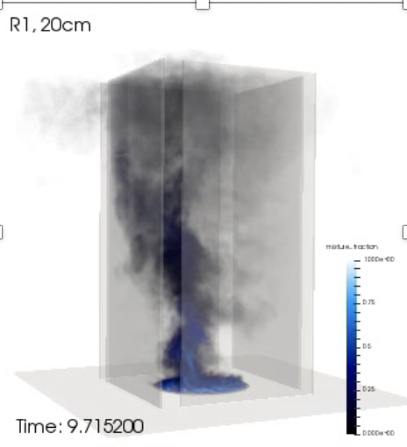
Objective: Deploy a High-Fidelity Tool to Predict a Fire
Consider that we want to develop and deploy a foundational understanding in fire physics and deploy a simulation tool to support production analysis
Consider the fire-environment with elements of the following physics:
Chemical reactions, soot, buoyancy, turbulent fluid mechanics, thermal radiation heat transfer, convective heat transfer, object heat-up/response, and sometimes propellants
Volume rendered mixture fraction

Slide 4
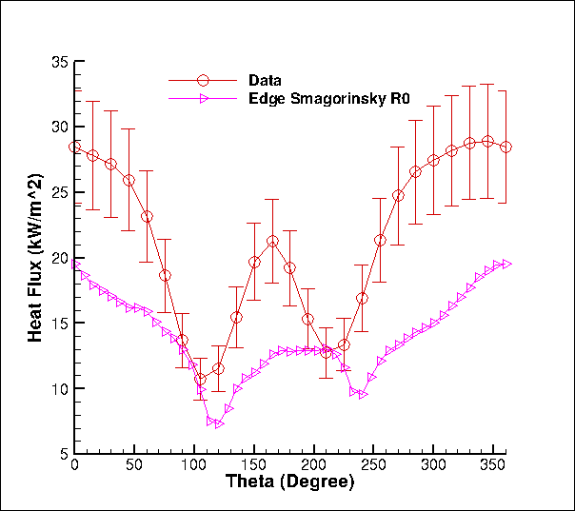
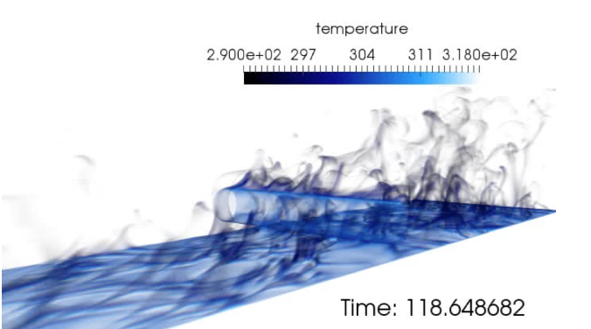
Conceptual Challenge: Distinguishing Between Model-form Error, Discretization Error, and Code Error
One mesh, one model, no code pedigree…
What credible scientific hypothesis can be tested in this context?
Was a Phenomalogical Identification and Ranking Table (PIRT) was conducted:
Process that defines 1) what you know, 2) what you think you know, and 3) what “you know not of”
Heat flux to the cylinder
Volume-rendered temperature
Time-averaged heat flux to cylinder

Slide 5
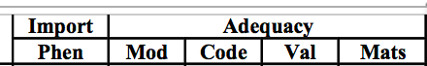
Step 1: Phenomena Identification and Ranking Table (PIRT)
Objective: Define a process that defines 1) what you know, 2) what you think you know, and 3) what “you know not of”
Once a particular use-case is understood and a PIRT is complete, one can proceed down the path of simply closing the gaps in the modeling, code implementation, and model validation process
Focus on one such element of convective heat transfer:
We think we have a good understanding of the modeling requirements
- and the code seems to have the models that we want – given our current understanding
However, high-quality validation experimental data is missing
Investment: Experimental campaign for mixed-convective heat transfer

Slide 6

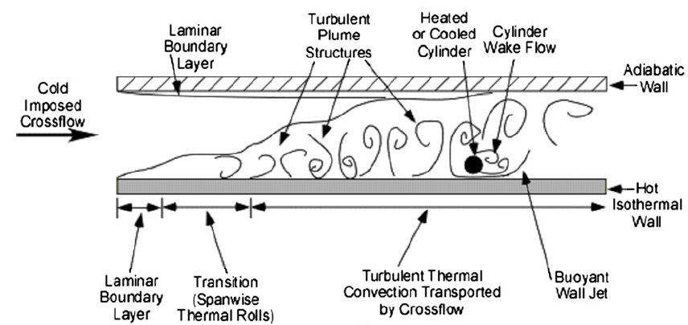
Turbulence Modeling in the Presence of Mixed Convection
Model Configuration: SNL-based Sean Kearney Experiment, “Experimental investigation of a cylinder in turbulent convection with an imposed shear flow”, AIAA, 2005
Present day RANS Conclusion: The presence of the heated bottom wall significantly challenged ability to predict the QoI (normal heat flux to cylinder)
Domino et al., CTRSP, 2016
Kearney experimental configuration
Laskowski et al., AIAA, 2007
RANS-based simulation (v2-f, k-e) study conducted by Laskowski et al., AIAA, 2007

Slide 7
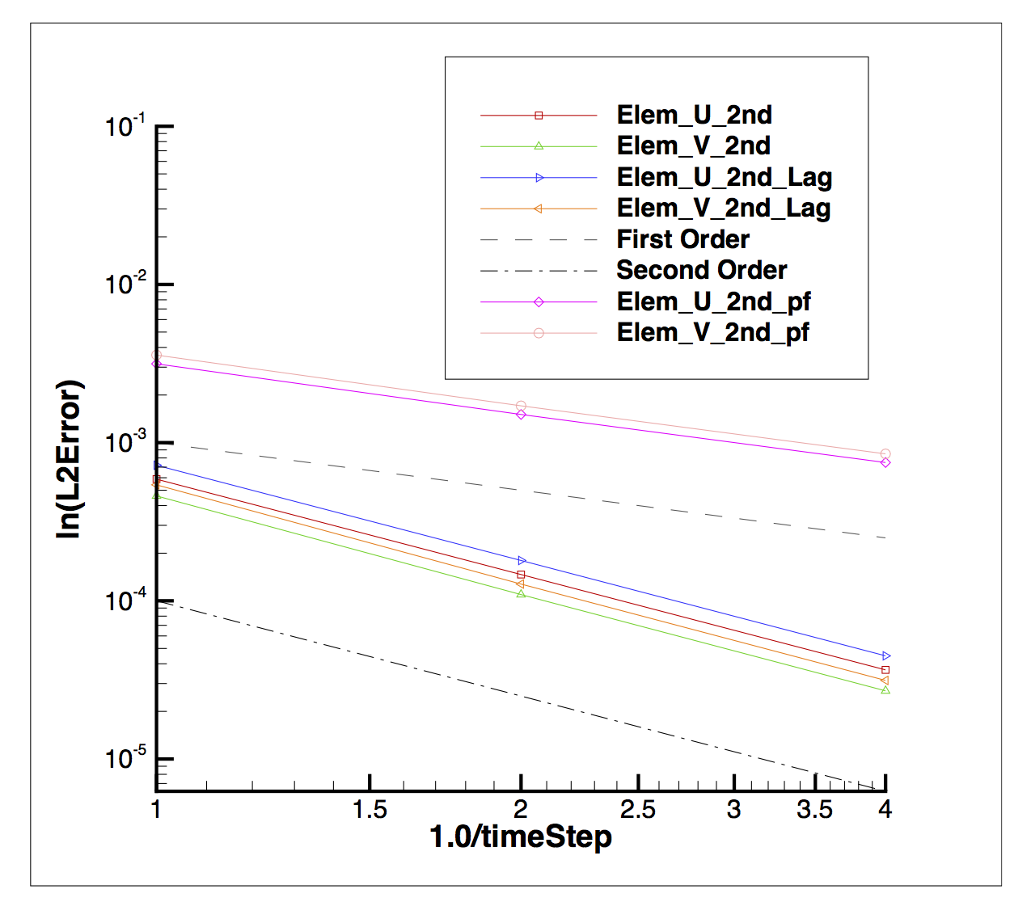
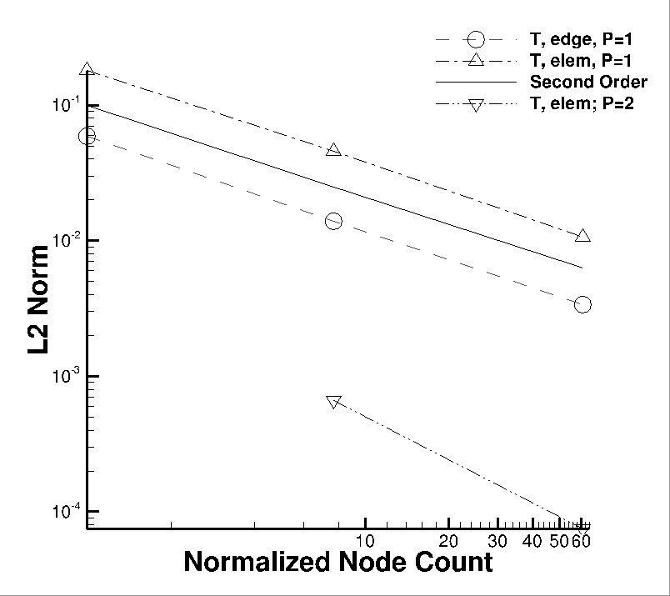
Essentials of Code Verification
Taxonomy: One verifies code and validates models
Code verification establishes the numerical accuracy of the underlying discretization for the given partial differential equation set
Code verification seeks to provide the temporal and spatial accuracy of the underlying discretization approach
For temporal discretization error,
a two-state Backward Euler time integrator should be first-order in time, specifically the error should scale with Δt
a three-state BDF2 time integrator should scale with Δt²
a multi-stake Runga-Kutta schemes can achieve higher-order accuracy
For spatial discretization error, a method is design-order if the observed order of accuracy is Δx^{P+1}, where P is the underlying polynomial order for interpolation

Slide 8
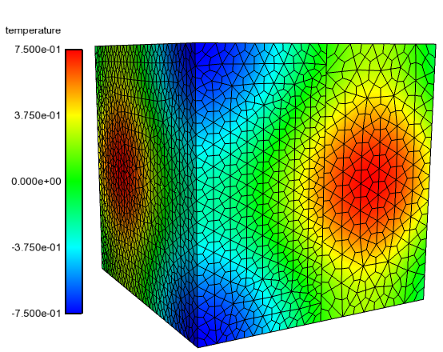
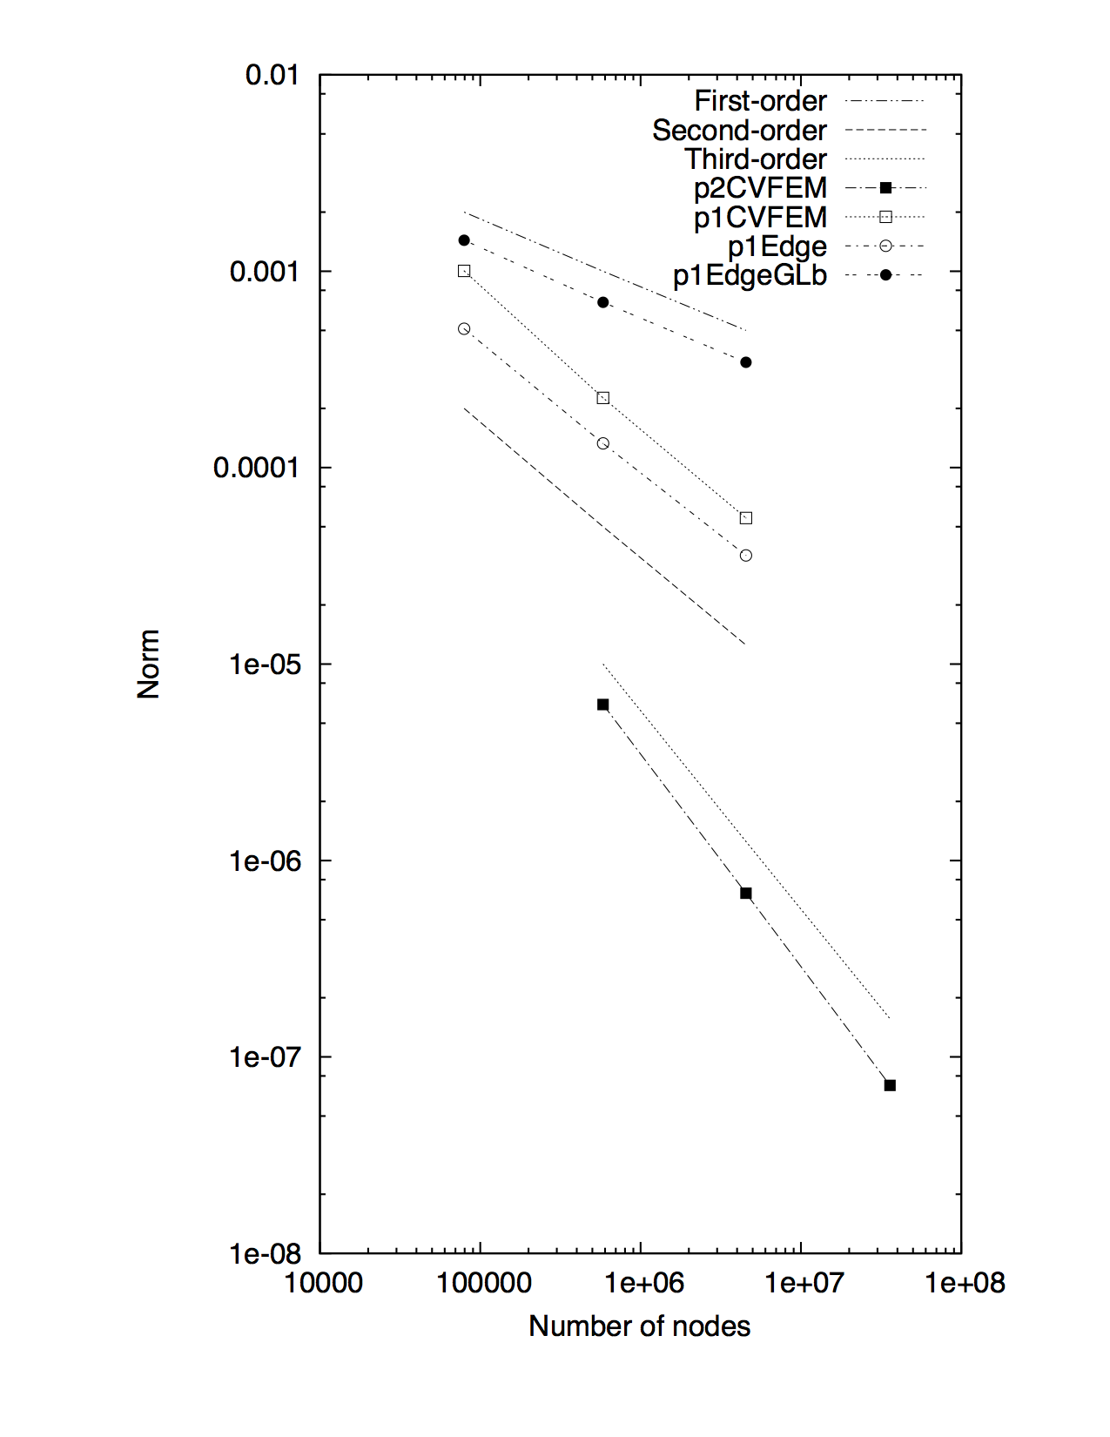
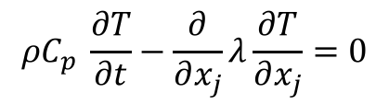
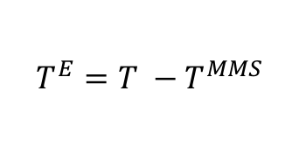
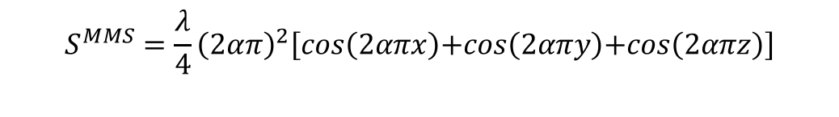
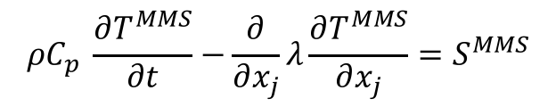
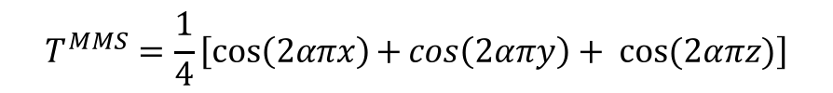
Introduction to the Method of Manufactured Solutions (MMS)
Providing confidence that the code implementation converges to the proper solution
For complex low-Mach fluid flow applications, there are very few analytical solutions
Consider an approach whereby the solution is manufactured (Roache, et al, 1990)
Simple thermal heat conduction PDE:
with manufactured analytical form for T:
Placing this MMS back into model PDE:
provides the source term:
with error now provided by:
$$ρC_{p} \frac{∂T}{∂t}−\frac{∂}{∂x_{j}}λ\frac{∂T}{∂x_{j}}=0$$
$$T^{MMS}=\frac{1}{4}\left[\cos\left(2απx\right)\text{+}\cos\left(2απy\right)+ cos⁡(2απz)\right]$$
$$ρC_{p} \frac{∂T^{MMS}}{∂t}−\frac{∂}{∂x_{j}}λ\frac{∂T^{MMS}}{∂x_{j}}=S^{MMS}$$
$$S^{MMS}=\frac{λ}{4}{\left(2απ\right)}^{2}\left[cos\left(2απx\right)\text{+}cos\left(2απy\right)\text{+}cos\left(2απz\right)\right]$$
$$T^{E}={T −T}^{MMS}$$

Slide 9
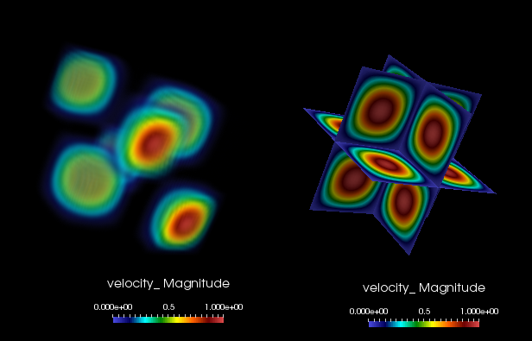
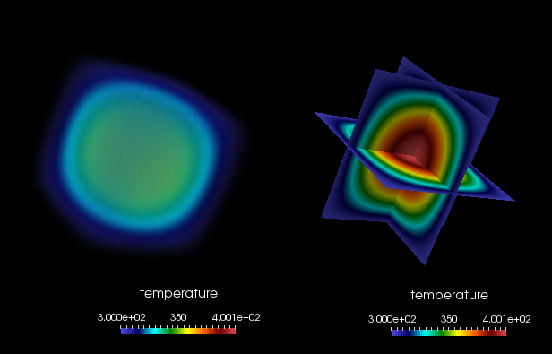
Spatial Code Verification for a low-Mach, Variable-Density Flow
Density is a function of static enthalpy transport via the standard ideal gas, ρ = f(P,M,R,T)
Temperature range maps to experiment
Arbitrary buoyancy source term via rotated gravity vector
Collective study now provides confidence in the interplay between numerical and modeling accuracy
See, “Exploring model-form uncertainties in large-eddy simulations”, Domino et al, 2016
Velocity Mag
Temperature

Slide 10
Spatial Code Verification for a low-Mach, Variable-Density Flow
Density is a function of static enthalpy transport via the standard ideal gas, ρ = f(P,M,R,T)
Temperature range maps to experiment
Arbitrary buoyancy source term via rotated gravity vector
Collective study now provides confidence in the interplay between numerical and modeling accuracy
See, “Exploring model-form uncertainties in large-eddy simulations”, Domino et al, 2016
Velocity Mag
Temperature

Slide 11
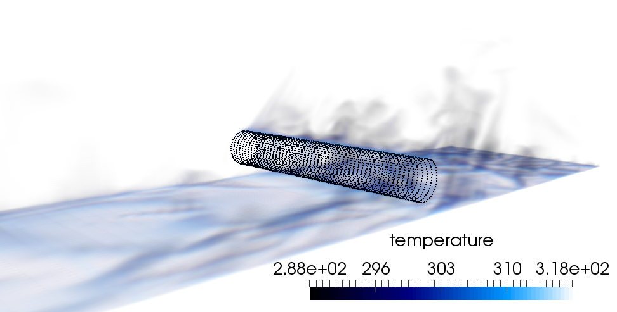
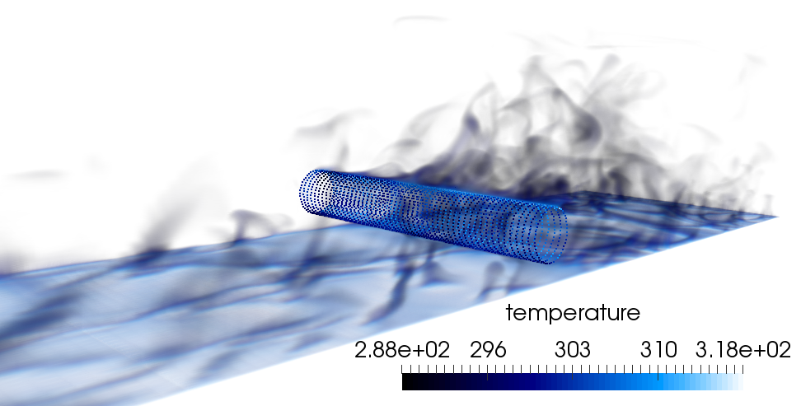
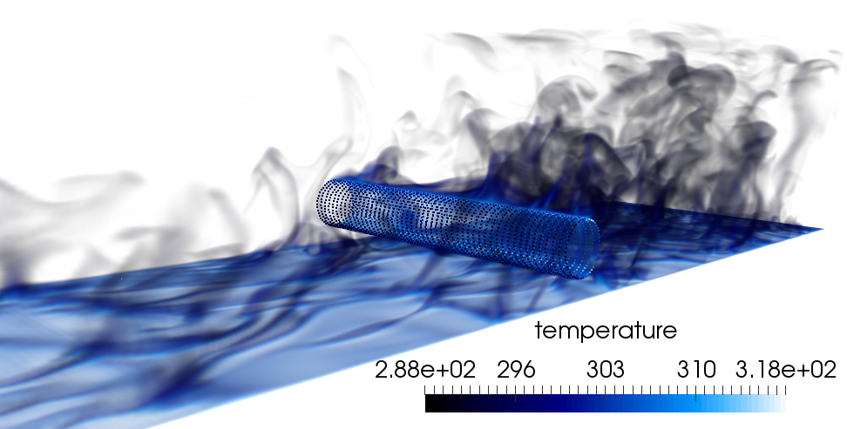
The Effect of Polynomial (P) and Mesh Spacing (H) Refinement
For the heated cylinder-in-cross flow, either mesh resolution or polynomial promotion provides a more accurate result with more turbulence structure
P=1, R0
P=1, R1
P=1, R2
P=2, R0

Slide 12
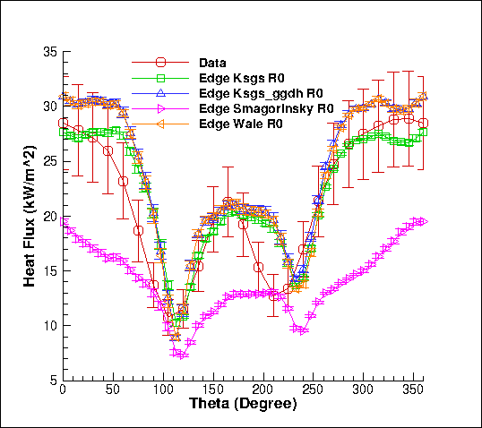
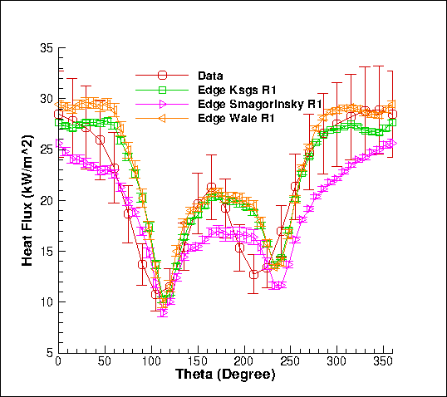
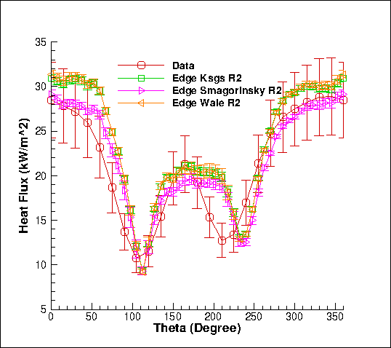
Solution Verification and Due Diligence for Model-form (Structural) Uncertainty
Three meshes, three models
The heat flux results also show error bars due to time and spatial averaging over a line-of-site
Can we yet feel confidence in any scientific statement?

Slide 13
Solution Verification and Due Diligence for Model-form (Structural) Uncertainty
Three meshes, three models
The heat flux results also show error bars due to time and spatial averaging over a line-of-site
Can we yet feel confidence in any scientific statement?

Slide 14
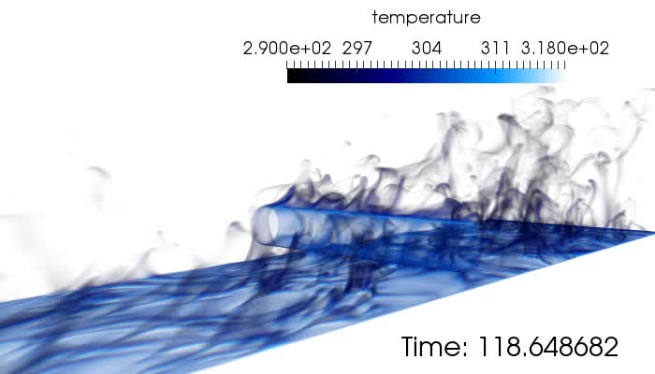
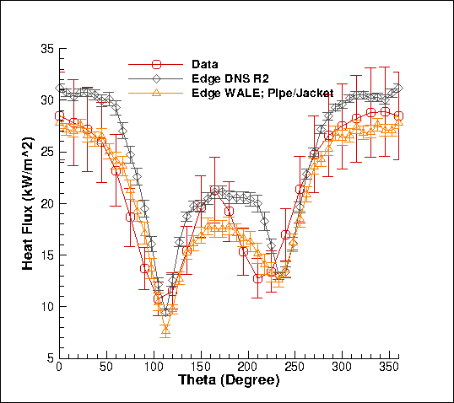
Review of a Strong V&V Process LES-based
Numerical UQ
Established a sound LES-based verification and validation process (with uncertainty quantification) that includes the following attributes:
Definition of key physics, Phenomena Identification Ranking Table (PIRT)
Code implementation and verification
Validation including solution verification (meshes with converged statistics)
Structural uncertainty, i.e., model form, quantification
Physics assumptions
Structural UQ
Non-isothermal MMS
Physics UQ
10x
reduction
“An assessment of atypical mesh topologies for low-Mach LES”, Domino et al., Comp & Fluids, 2019

Slide 15
A Validation Methodology: Code and Solution Verification: Conclusions
A validation pedigree includes understanding what models are to be implemented, what code verification is required, and a detailed solution verification
A PIRT is a simple process that identifies gaps in models, code, and/or, validation
Typical validation studies often include one mesh, one model and lack of any code verification
As a general rule, it takes 10x longer to verify correctness than to implement the code capability
Code verification is hard work, however, is critical to numerical methods development
Violations of this rule are abundant– especially when the code implementation is really really hard, e.g., NGP on GPU
For structural uncertainty, i.e., model-form sensitivity, eigenvalue perturbation procedures can be a good approach

Slide 16
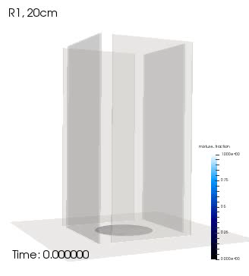
Objective: Deploy a High-Fidelity Tool to Predict a Fire
Consider that we want to develop and deploy a foundational understanding in fire physics and deploy a simulation tool to support production analysis
Consider the fire-environment with elements of the following physics:
Chemical reactions, soot, buoyancy, turbulent fluid mechanics, thermal radiation heat transfer, convective heat transfer, object heat-up/response, and sometimes propellants
Volume rendered mixture fraction

Slide 17
More Effective/Efficient Structural Uncertainty
In the previous high-quality LES validation (cylinder in x-flow), three models were implemented and tested
Is there a more efficient approach? Yes! Eigenvalue perturbation of the SGS stress
See “Framework for characterizing structural uncertainty in LES”, Jofre et al, 2017

Slide 18
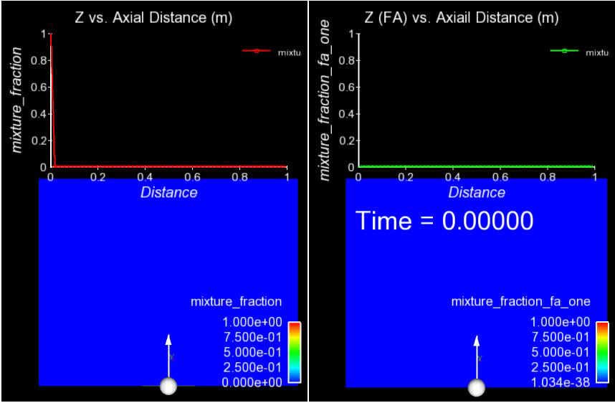
For Transient, Turbulent Flows, Averaging is Required
The bane of turbulent validation: converged statistics require many flow-through times

